Slide 1
Speech Synthesis

Slide 2
Text to Speech
“Text-to-Speech software is used to convert words from a computer document (e.g. word processor document, web page) into audible speech spoken through the computer speaker”

Slide 3
Text to Speech Synthesis System
Text Normalization
Conversion of Text that include non standard word
    Abbreviation (like )
    Numbers (like)
Text processing
Grapheme to Phoneme (Pronunciation)
Prosody
    Syllabification
    Phrase/clause marking
    Prosody and Intonation
Synthesis

Slide 4
Numbers
Deciding how to convert numbers is another problem TTS systems have to address.
It is a fairly simple programming challenge to convert a number into words, like 1325 becoming "one thousand three hundred twenty-five".
However, numbers occur in many different contexts in texts, and 1325 should probably be read as "thirteen twenty-five" when part of an address (1325 Main St.) and as "one three two five" if it is the last four digits of a social security number.
Often a TTS system can infer how to expand a number based on surrounding words, numbers, and punctuation, and sometimes the systems provide a way to specify the type of context if it is ambiguous.

Slide 5
Abbreviations
Similarly, abbreviations like "etc." are easily rendered as "et cetera", but often abbreviations can be ambiguous.
For example, the abbreviation "in." in the following example: "Yesterday it rained 3 in. Take 1 out, then put 3 in."
"St." can also be ambiguous: "St. John St."
TTS systems with intelligent front ends can make educated guesses about how to deal with ambiguous abbreviations, while others do the same thing in all cases, resulting in nonsensical but sometimes comical outputs: "Yesterday it rained three in." or "Take one out, then put three inches."

Slide 6
Text-to-phoneme challenges
Speech synthesis systems use two basic approaches to determine the pronunciation of a word based on its spelling, a process which is often called text-to-phoneme or grapheme-to-phoneme conversion, as phoneme is the term used by linguists to describe distinctive sounds in a language.

Slide 7
Dictionary Based approach
The simplest approach to text-to-phoneme conversion is the dictionary-based approach, where a large dictionary containing all the words of a language and their correct pronunciation is stored by the program. Determining the correct pronunciation of each word is a matter of looking up each word in the dictionary and replacing the spelling with the pronunciation specified in the dictionary.
Pronunciations lexicon format of W3C (PLS)

Slide 8
<?xml version="1.0" encoding="UTF-8"?>
<!-- This pronunciation lexicon is licensed under the GPL. -->
<lexiconversion="1.0"
xmlns="http://www.w3.org/2005/01/pronunciation-lexicon"
xmlns:xsi="http://www.w3.org/2001/XMLSchema-instance"
xsi:schemaLocation="http://www.w3.org/2005/01/pronunciation-lexicon
http://www.w3.org/TR/2007/CR-pronunciation-lexicon-20071212/pls.xsd"
alphabet="ipa" xml:lang="bn">
<lexeme>
<grapheme>আমি</grapheme>
<phoneme>ɐmi</phoneme>
</lexeme>
<lexeme>
<grapheme>ছাড়া</grapheme>
<phoneme>ʧʰɐɽɐ</phoneme>
</lexeme>
<lexeme>
<grapheme>দ্বিতীয়</grapheme>
<phoneme>ditijo</phoneme>
</lexeme>
<lexeme>
<grapheme>কেউ</grapheme>
<phoneme>keu</phoneme>
</lexeme>
</lexicon>

Slide 9
Rule based approach
The other approach used for text-to-phoneme conversion is the rule-based approach, where rules for the pronunciations of words are applied to words to work out their pronunciations based on their spellings. This is similar to the "sounding out" approach to learning reading.
Hybrid approach

Slide 10
Speech Synthesis
Articulatory
Parametric
    Formant Synthesis
    HMM based TTS
Concatenative
    Di-Phone Synthesis
    Element Based (ESNOLA)
    Unit selection
    Unit Selection with Prosodic Modification
    HMM based speech synthesis

Slide 11
Articulatory synthesis
In an articulatory synthesis, models of the human articulators (tong, lips, teethes, jaw) and vocal ligament are used to simulate how an airflow passes through, to calculate what the resulting sound will be like. It is a great challenge to find good mathematical models and therefore the development of articulatory synthesis is still in research. The technique is very computation-intensive but memory requirements is almost nothing.

Slide 12
Formant Synthesis
This synthesis is a sort of source-filter-method that is based on mathematic models of the human speech organ. The approach pipe is modelled from a number of resonances with resemblance to the formants (frequency bands with high energy in voices) in natural speech.
The first electronic voices Voder, and later on OVE and PAT, were speaking with totally synthetic and electronic produced sounds using formant synthesis. As with articulatory synthesis, the memory consumption is small but CPU usage is large.

Slide 13
Formant Synthesis
Formant synthesis does not use any human speech samples at runtime. Instead, the output synthesized speech is created using an acoustic model.
Parameters such as frequency amplitude etc are varied over time to create a waveform of artificial speech.

Slide 14
Concatenating synthesis
A concatenating synthesis is made of recorded pieces of speech (sound-clips) that is then unitized and formed to speech.
Depending on the length of sound-clips that are used it become a diphone or a polyphonic synthesis.
The latter in a more developed version is also called a Unit Selection synthesis, where the synthesizer has access to both long and short segments of speech and the best segments for the actual context is chosen

Slide 15
Diphone TTS architecture
Training:
  Choose units (kinds of diphones)
  Record 1 speaker saying 1 example of each diphone
  Mark the boundaries of each diphones,
    cut each diphone out and create a diphone database
Synthesizing an utterance,
  grab relevant sequence of diphones from database
  Concatenate the diphones, doing slight signal processing at boundaries
  use signal processing to change the prosody (F0, energy, duration) of selected sequence of diphones

Slide 16
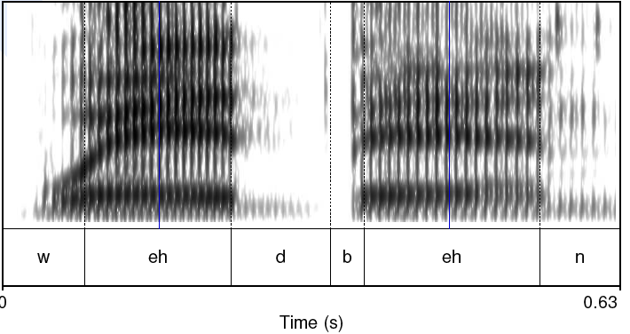
Diphones
Mid-phone is more stable than edge:

Slide 17
Designing a diphone inventory:
Nonsense words
Build set of carrier words:
  pau t aa b aa b aa pau
  pau t aa m aa m aa pau
  pau t aa m iy m aa pau
  pau t aa m iy m aa pau
  pau t aa m ih m aa pau
Advantages:
  Easy to get all diphones
  Likely to be pronounced consistently
    No lexical interference
Disadvantages:
  (possibly) bigger database
  Speaker becomes bored

Slide 18
Designing a diphone inventory:
Natural words
Greedily select sentences/words:
  Quebecois arguments
  Brouhaha abstractions
  Arkansas arranging
Advantages:
  Will be pronounced naturally
  Easier for speaker to pronounce
  Smaller database? (505 pairs vs. 1345 words)
Disadvantages:
  May not be pronounced correctly

Slide 19
Making recordings consistent:
Diiphone should come from mid-word
  Help ensure full articulation
Performed consistently
  Constant pitch (monotone), power, duration
Use (synthesized) prompts:
  Helps avoid pronunciation problems
  Keeps speaker consistent
  Used for alignment in labeling

Slide 20
Architecture of the ESNOLA System
Unicode Text
Text Analyzer
Temp
File
Phone Syll+Ty Word TyC/P
Prosodic
Rule
Table
Prosodic Analyzer
Signal
Dic.
Temp
File
Phone Syll+Ty Word TyC/P Amp Dura Pitch
Synthesis Engine
Resources
Adequate Intonated Synthesized speech

Slide 21
Token generation
1. CVCV. C +CV+V+VC+C+V+V_{o}
बाजे /baaje/
b+baa +aa+aaj+j+je+e+e_{o}
2. VCV. V_{i}+V +VC+C+CV+V+V_{o}
आगे /aage/
aa_{i}+aa+aag+g+ge+e+e_{o}
3. CVYV. C +CV+V+VY+YV+V_{o}
रोयो /royo/
r+ro+o+oy+y+yo+o+o_{o}
भजन् /bhajon/
bha
a
aj
jo
o
on
bh
j
n

Slide 22
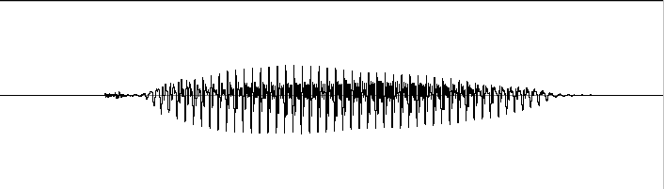
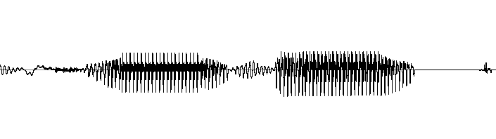
ESNOLA Method Based Speech Synthesis
System for Bangla
Concatenative synthesis is based on putting together pieces ( acoustic unit) of natural(recorded) speech to synthesized an arbitrary utterance
C
CV
V
VC
C
C
CV
V
VC
C
bh
bhaa
aa
aar
r
ra
a
at
t
/bhaarat/
* Epoch Synchronous Non-OverLapping Add

Slide 24
What is Prosody ? --- The Author’s Definition
(Fujisaki 1995)
Prosody is defined as the systematic organization of
individual linguistic units into an utterance, or a coherent
group of utterances, in the process of speech production.
Its realization involves both segmental and suprasegmental
features of speech, and is influenced, not only by linguistic
information, but also by para-linguistic and non-linguistic
information.
© Hiroya Fujisaki
IWSLPR-2009, Kolkata

Slide 25
Role of Voice Fundamental Frequency (F₀ ) Contour
・ In many languages, the pattern of temporal changes in F₀ (henceforth the F₀ contour) is used to express tone, accent, and intonation, and plays a major role in conveying linguistic information on the prosody (i.e., the structural organization of various linguistic units into a coherent utterance or a coherent group of utterances).
・ It can convey also para-linguistic information concerning speaker’s intention and attitude, as well as non-linguistic information concerning speaker’s physical and mental states (such as age, emotion, etc.)
© Hiroya Fujisaki
IWSLPR-2009, Kolkata

Slide 26
Three Approaches to the Description/Representation of F₀ Contour Characteristics
Coding/
Example
Outcome
Method
Decoding
Subjective
Qualitative
Labeling
ToBI
Discrete Labels
Irreversible
Stylization
Piece-wise
Subjective
Quantitative
Irreversible
’t Hart
Linear Approx.
Timing and
Magnitude of
Commands
Objective
Quantitative
Modeling
Fujisaki
Reversible
© Hiroya Fujisaki
IWSLPR-2009, Kolkata

Slide 27

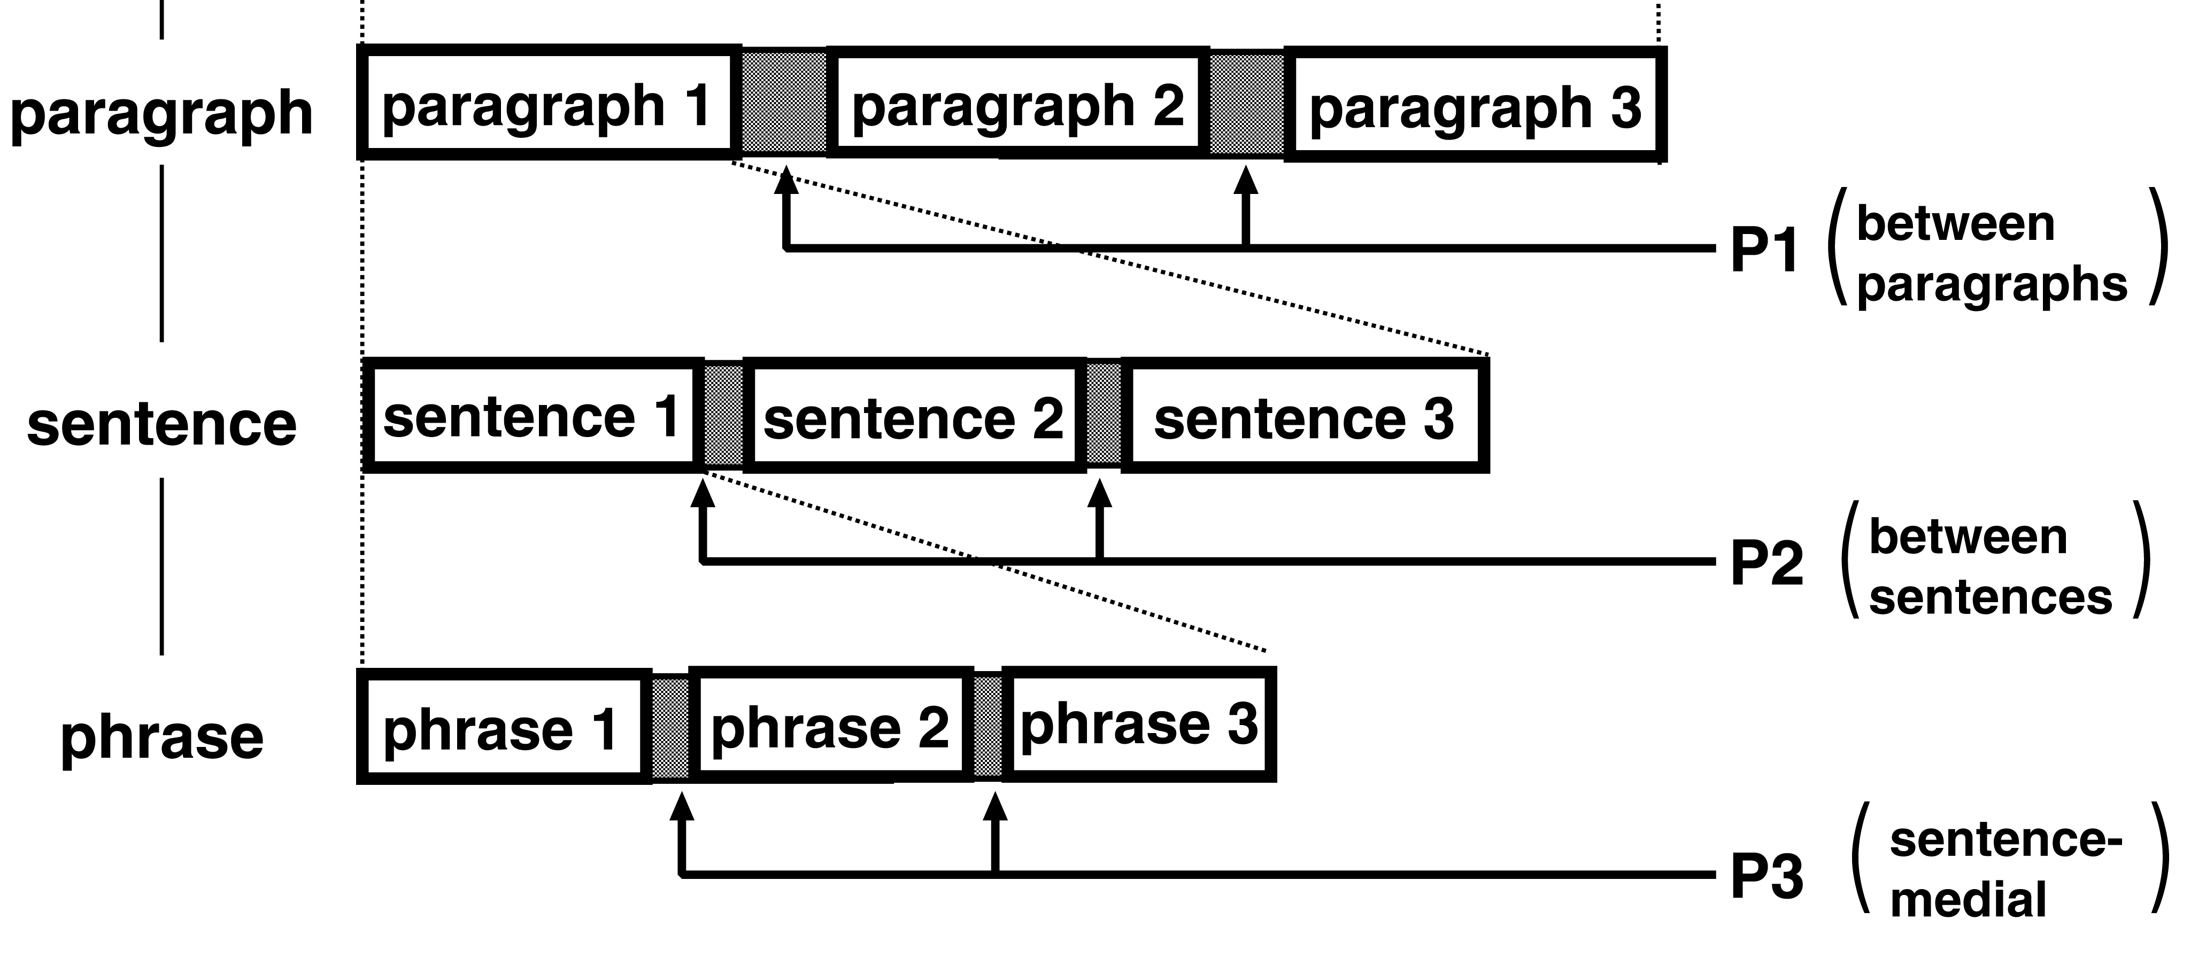
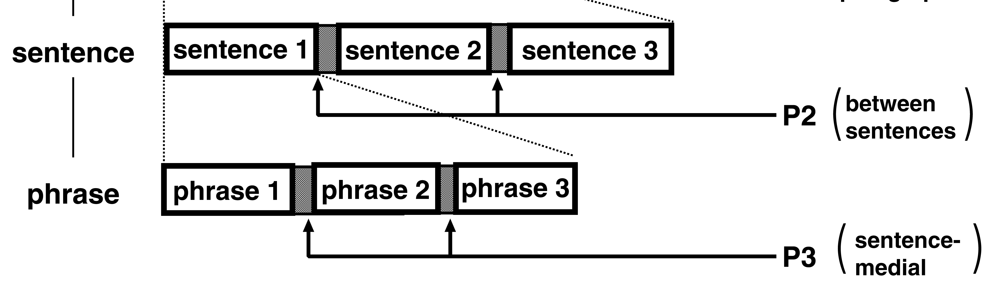
Prosodic Structure
written
spoken
text
discourse
discourse
paragraph
DS 1
DS 2
DS 3
DS: discourse
segment
pause between
paragraphs
sentence
SS 1
SS 2
SS 3
SS: spoken sentence
pause between
sentences
)
clause
PC 1
PC 2
PC 3
PC: prosodic clause
pause within
a sentence
phrase
PP1
PP2
PP3
PP: prosodic phrase
word
PW1
PW2
PW3
PW: prosodic word

Slide 28
Speech Parameters controlling the Supra-segmental Features
Pause
Duration
Intonation(F0 model)
Loudness(Amplitude model)

Slide 29
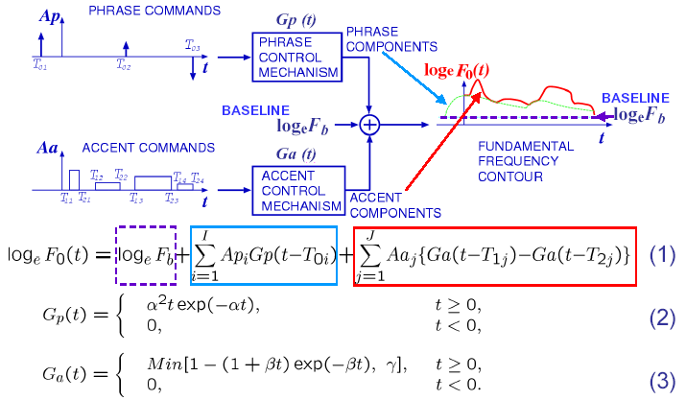
A functional model for the process of generating F0 contours

Slide 30
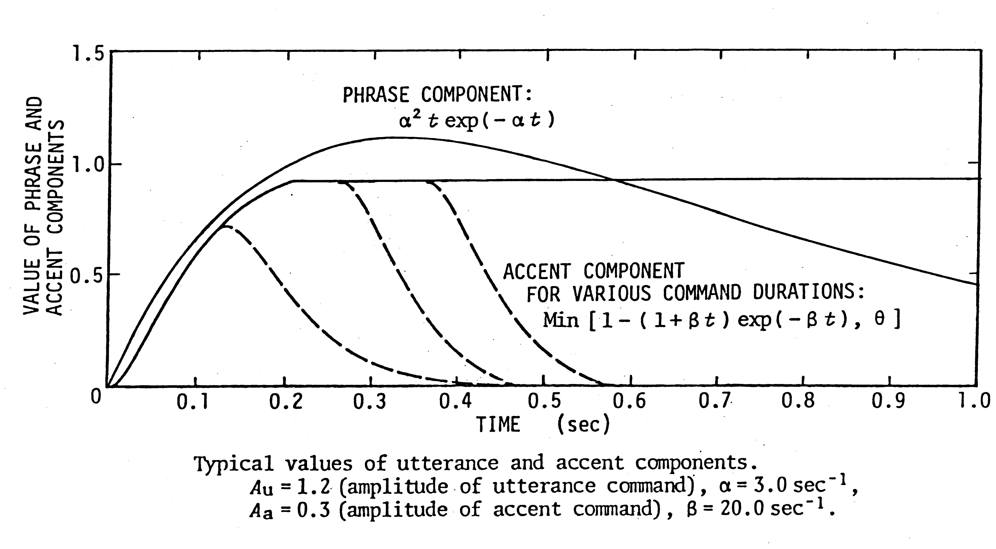
Shapes of phrase and accent components with typical values of α, βand γ
(Ap = 1)
S
(Aa = 1)
γ
Parameter values for the phrase component: α= 3.0/s,
the accent components: β= 20.0/s, γ= 0.9.
© Hiroya Fujisaki
© Hiroya Fujisaki
IWSLPR-2009, Kolkata

Slide 31
Stress-strain relationship of skeletal muscles
  The stress-strain relationship of skeletal muscles
including the human vocalis muscle has been
widely studied [e.g., Buchthal & Kaiser 1944,
Sandow, 1958].
The next figure shows the earliest published data
on the relationship between tension and stiffness
of a skeletal muscle by Buchthal and Kaiser
published in Acta Physiol. Scand.
© Hiroya Fujisaki
IWSLPR-2009, Kolkata

Slide 32
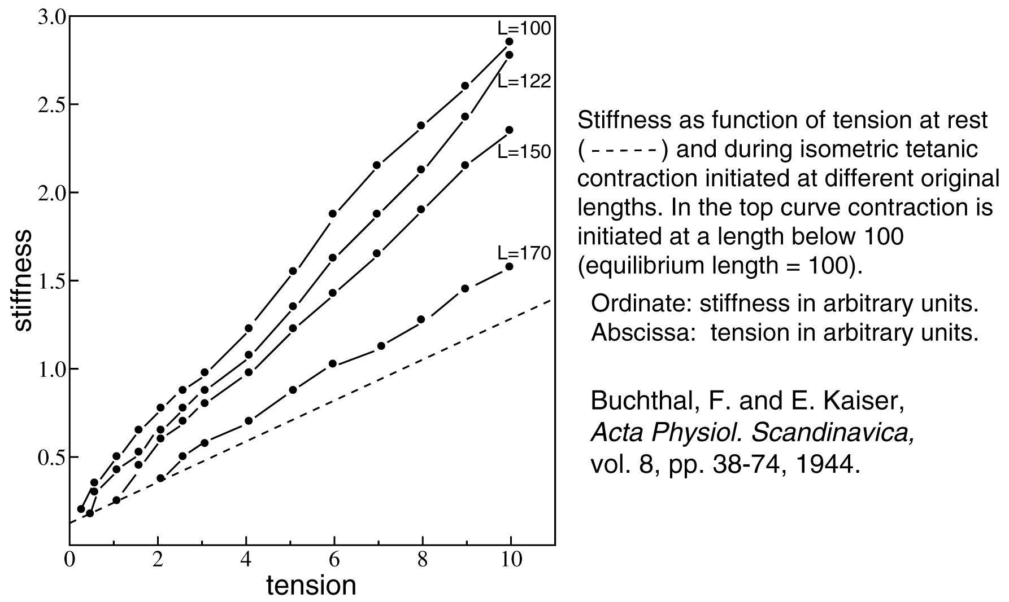
Physical properties of skeletal muscles (1)
© Hiroya Fujisaki
IWSLPR-2009, Kolkata

Slide 33
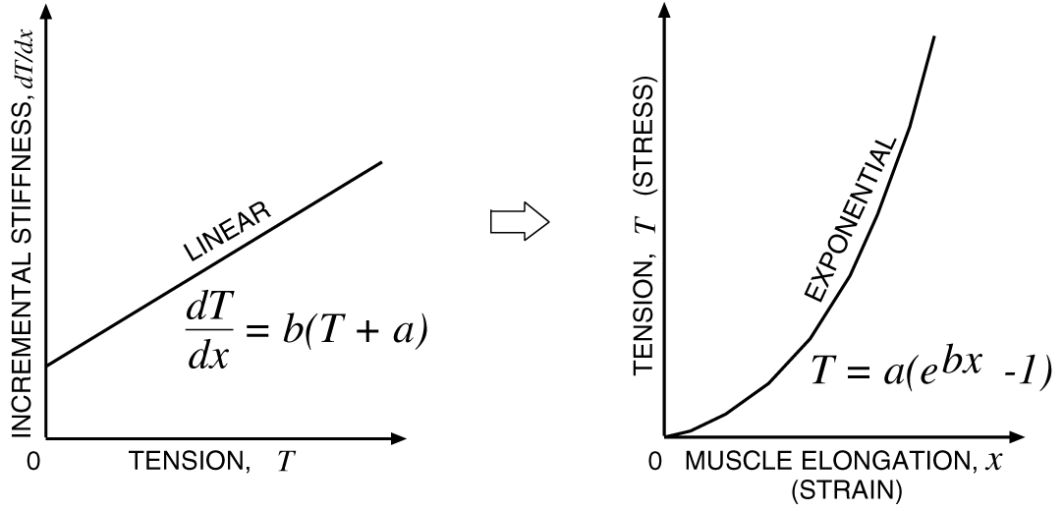
Physical properties of skeletal muscles (2)
© Hiroya Fujisaki
IWSLPR-2009, Kolkata

Slide 34

From vocal cord elongation to tension
Stress-strain relationship in a skeletal muscle (i.e., vocalis)
dT/dl = b (T + a), (1)
where T: tension, l : length of vocalis, a: stiffness at T = 0.
By integration, we obtain
T = (T₀ + a/b) exp{b(l – l₀)} – a/b, (2)
where T₀: static tension, l₀: vocalis length at T = T₀.
When T₀ >> a/b, T T₀ exp (bx). (3)
where x = l – l_{0.}
≈
© Hiroya Fujisaki
IWSLPR-2009, Kolkata

Slide 35
From vocal cord tension to fundamental frequency
Frequency of vibration of an elastic membrane is given by
F₀ = c₀{T/σ}^{1/2}, where σ : density/unit area. (4)
From Eqs. (3) and (4) we obtain
log_{e} F₀ = log_{e}[c₀{T₀ / σ}^{1/2}] + (b/2)x. (5)
When x is time-varying, i.e., x = x (t),
log_{e} F₀(t) = log_{e} F_{b} + (b/2) x(t), (6)
where F_{b} = c₀{T₀ / σ}^{1/2}.
Thus an F₀ contour, when plotted in the logarithmic scale
as a function of time, can be expressed as the sum of
a constant (baseline) term and a time-varying term, the
latter being proportional to the elongation of the vocal cord.
© Hiroya Fujisaki
IWSLPR-2009, Kolkata

Slide 36
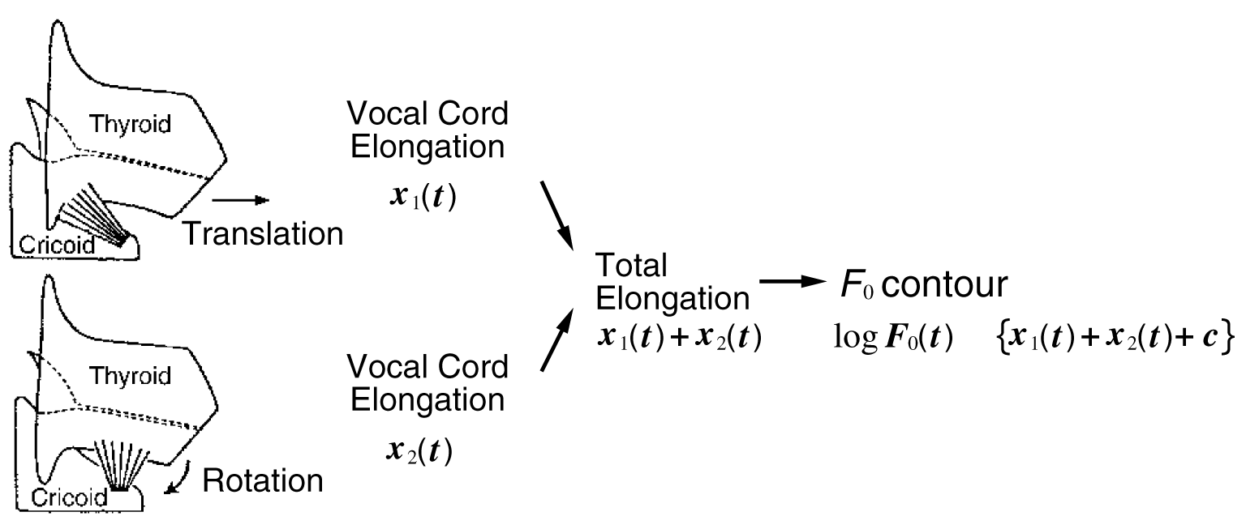
Additivity of phrase and accent components
∝
© Hiroya Fujisaki
IWSLPR-2009, Kolkata

Slide 37
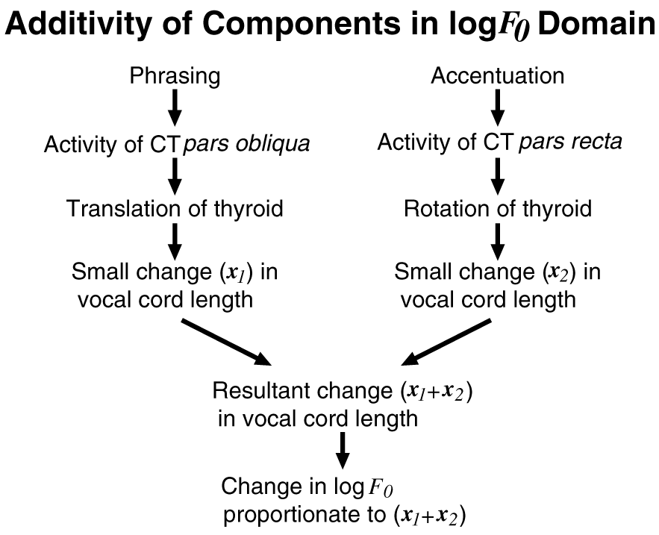
Additivity of components in logF₀ domain
The term “Superposition”
applies only if one uses the logarithmic (i.e., semitone) scale for F₀.
© Hiroya Fujisaki
IWSLPR-2009, Kolkata

Slide 38
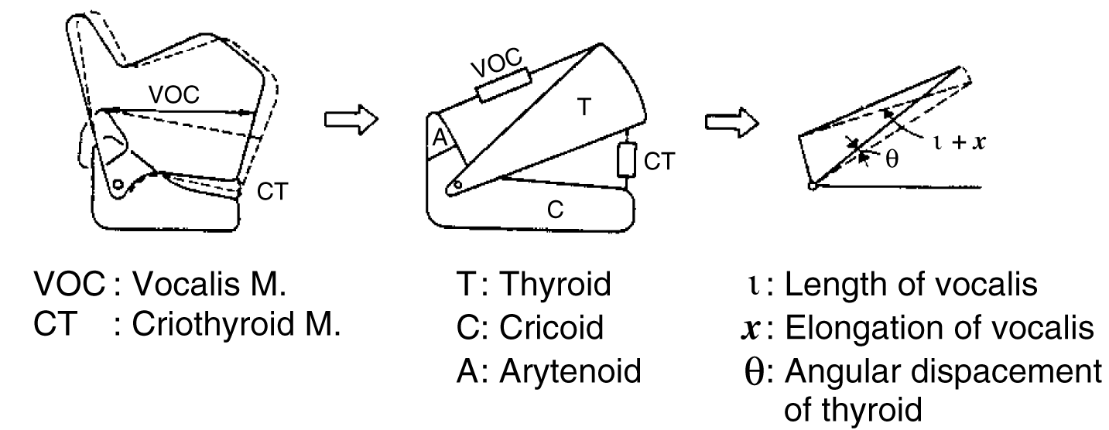
Thyroid and Cricoid Cartilages with
Vocalis and Cricothyroid Muscles
Forming a Two -Mass, Two -Spring System
© Hiroya Fujisaki
IWSLPR-2009, Kolkata

Slide 39
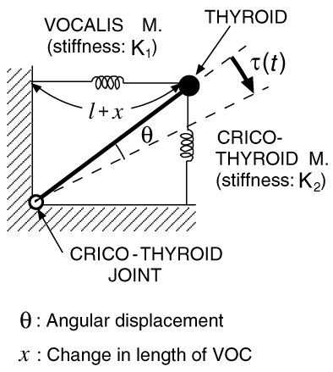
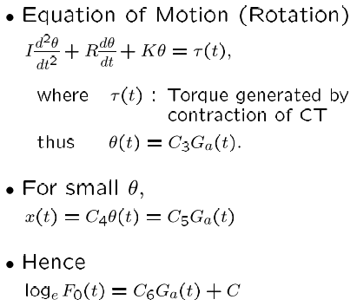
Rotation of thyroid around the crico-thyroid joint
© Hiroya Fujisaki
IWSLPR-2009, Kolkata

Slide 40
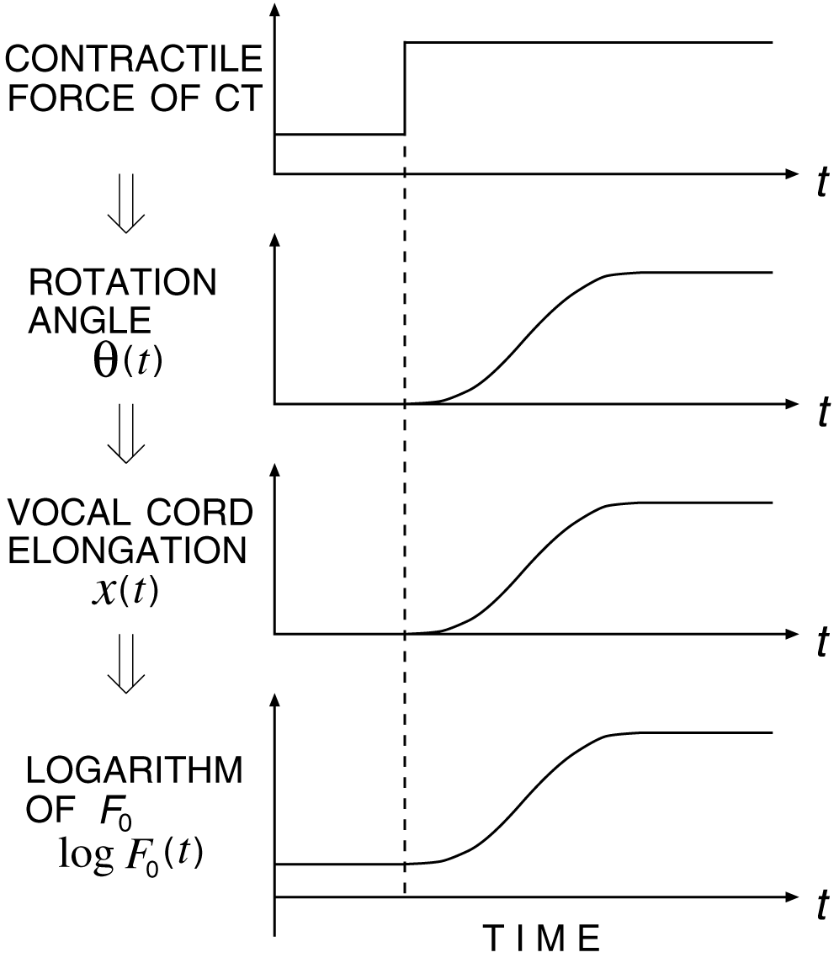
From cricothyroid activity to logarithm of F₀
The rate of F₀ change is determined, not by the
speed of contraction or relaxation of the muscle, but by the mechanical properties of the laryngeal structure.
The rate of change varies with the amplitude of the command, but the time constant remains the same.
(Fujisaki, 1981)
© Hiroya Fujisaki
IWSLPR-2009, Kolkata

Slide 41
The role of the cricothyroid (CT) muscle
Analysis of the laryngeal structure suggests that the movement of the thyroid cartilage has two degrees of freedom [e.g., Zemlin 1968, Fink & Demarest 1978].
One is rotation around the cricothyroid joint due to the activities of the pars recta of the cricothyroid muscle (henceforth CT) and the other is horizontal translation due to the activities of pars obliqua of CT.
© Hiroya Fujisaki
IWSLPR-2009, Kolkata

Slide 42
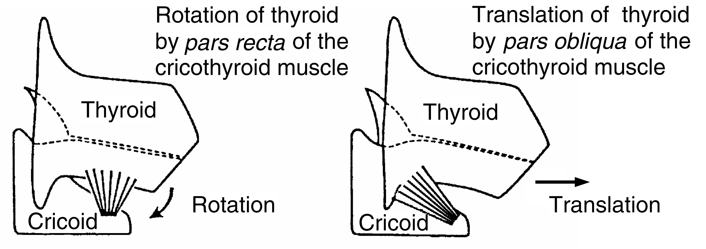
Motion of thyroid with two degrees of freedom
© Hiroya Fujisaki
IWSLPR-2009, Kolkata

Slide 43
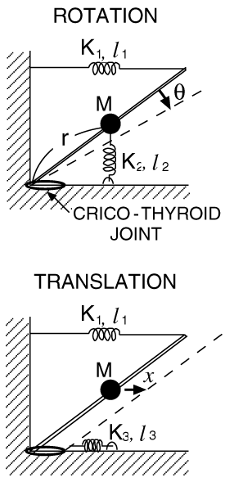
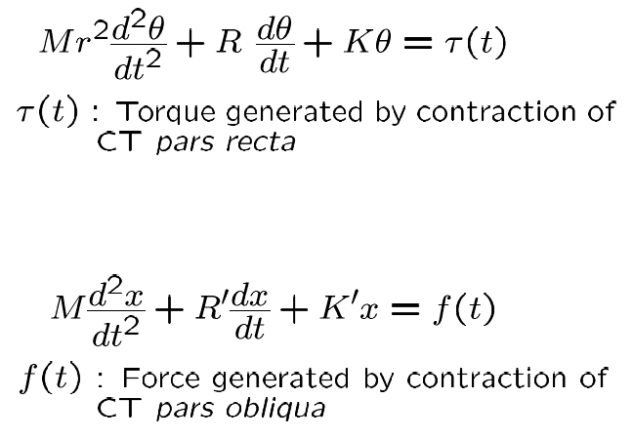
Rotation and translation of the thyroid
: Torque generated by contraction of
CT pars recta
: Force generated by contraction of
CT pars obliqua
© Hiroya Fujisaki
IWSLPR-2009, Kolkata

Slide 44
Analysis and Synthesis of F₀ Contours

Slide 45
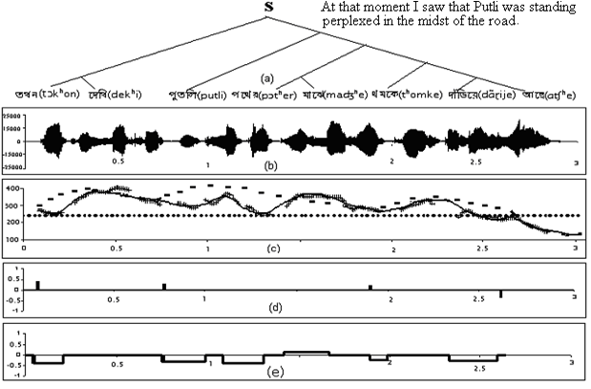

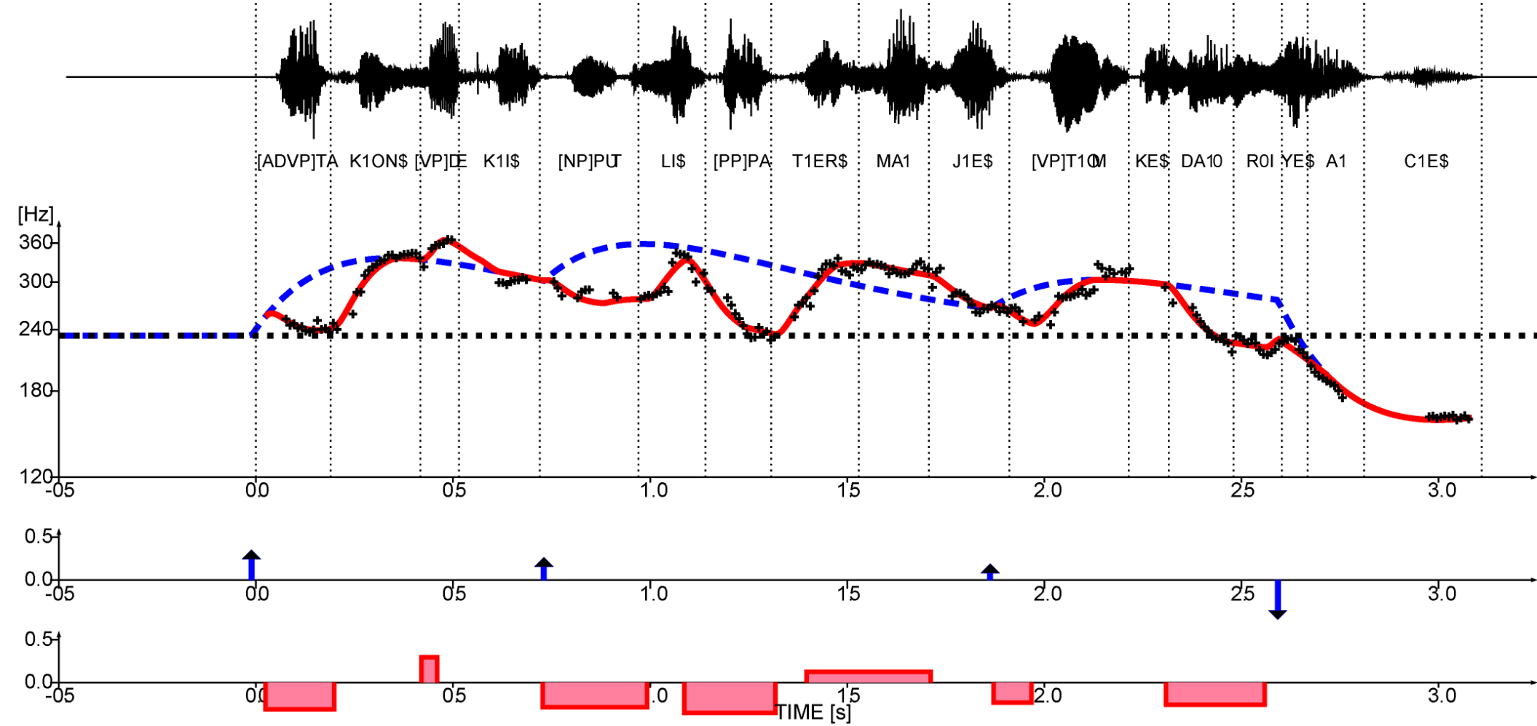
Analysis-by-Synthesis of the F₀ contour of an Utterance of a Bangla sentence
Translation in English:
Syntactic tree
PP: Prosodic Phrase
Original speech
PW: Prosodic Word
PP1
PP2
PP3
PW1
PW2
PW3
PW4
PW5
(b) Speech
waveform
(c) Analysis-by-Synthesis
of the F0 contour
Synthetic speech with model-generated F0 contour
(d) Phrase commands
(e) Accent commands
© Hiroya Fujisaki

Slide 46
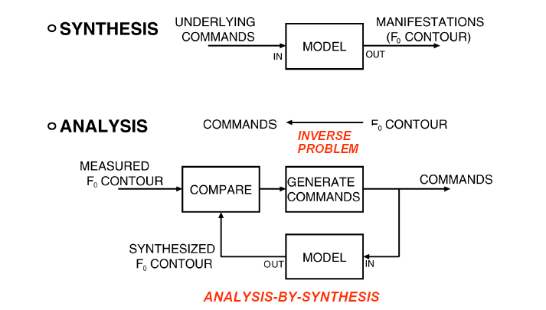
Use of a Generative Model in Synthesis and Analysis

Slide 47
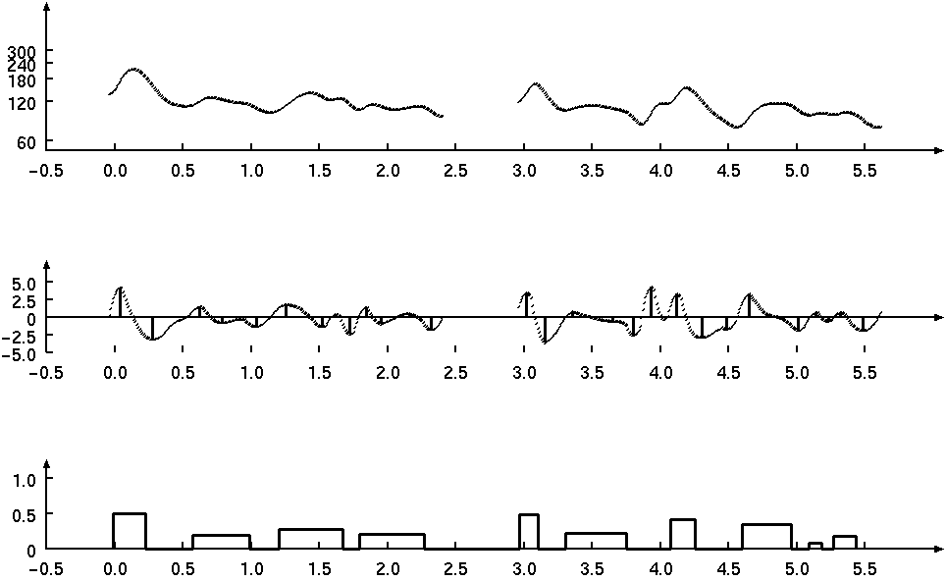
An example of estimation of first-order approximations of accent commands
(1) Smoothed F₀ contour
F₀ (t) [Hz]
t [s]
(2) First derivative
derivative
t [s]
(3) First-order approximations of accent commands
t [s]

Slide 48
Estimation of first-order approximations of accent commands
Smoothed F₀ contour
Calculation of derivative
Detection of inflection points
Estimation of onset and offset
Estimation of amplitude
Accent commands

Slide 49
Estimation of first-order approximations of phrase commands
Smoothed F₀ contour
Accent commands
+
-
R₀(t)
Synthesis of accent components
Estimation of initial command
Estimation of magnitude
Synthesis of
phrase component
+
-
R₁(t)
Integration of residual contour
Estimation of medial commands
R_{i}(t)
Synthesis of
phrase components
Estimation of magnitude
+
-
Phrase commands

Slide 50



An Example of Disparity Between the Syntactic Structure
and the Prosodic Structure
SYNTACTIC STRUCTURE
S
PW
PP
PC
PW: Prosodic Word
PP : Prosodic Phrase
PC : Prosodic Clause
PROSODIC STRUCTURE
© Hiroya Fujisaki

Slide 51
Syntactic Structure vs. Prosodic Structure
(Fujisaki 1984)
An Example of Disparity Between the Syntactic Structure
and the Prosodic Structure
S
Syntactic Structure
of ａ Ｓｅｎｔｅｎｃｅ
PW
PP
PC
Prosodic Structure
of ａn Utterance
PW: Prosodic Word
PP : Prosodic Phrase
PC : Prosodic Clause

Slide 52
Relationship between F₀ model parameters and prosodic units
Prosodic Phrase
  The constituents of a prosodic phrase in Bangla can be one or more than one syntactic phrase depending on the length of the phrase
  Prosodic phrase can be defined on the basis of the phrase command
  The placement of phrase commands is related to the syntactic structure, but they occur mostly at deeper syntactic boundaries.
  The magnitudes of the consecutive phrase commands within an utterance have a general tendency of decreasing
  The initiation of the phrase command always leads the segmental onset of the corresponding prosodic phrase by a few hundred milliseconds.

Slide 53
Relationship between F₀ model parameters and prosodic units (cont’d)
Prosodic Word
  The syntactic constituents of a prosodic word may be a sequence of one or more content words followed by one or more function words
  Prosodic word of Bangla can be defined on the basis of the accent command
  Most of the prosodic words in Bangla can be modeled using one negative accent command at the beginning
  Prosodic words (polysyllabic) that are emphasized or that contain suffix can be modeled using one negative accent command followed by one positive accent command

Slide 54
Analysis-by-Synthesis of the F₀ contour of an Utterance of a Bangla sentence
Translation in English:
Syntactic tree
PP: Prosodic Phrase
Original speech
PW: Prosodic Word
PP1
PP2
PP3
PW1
PW2
PW3
PW4
PW5
(b) Speech
waveform
(c) Analysis-by-Synthesis
of the F0 contour
Synthetic speech with model-generated F0 contour
(d) Phrase commands
(e) Accent commands
© Hiroya Fujisaki

Slide 55
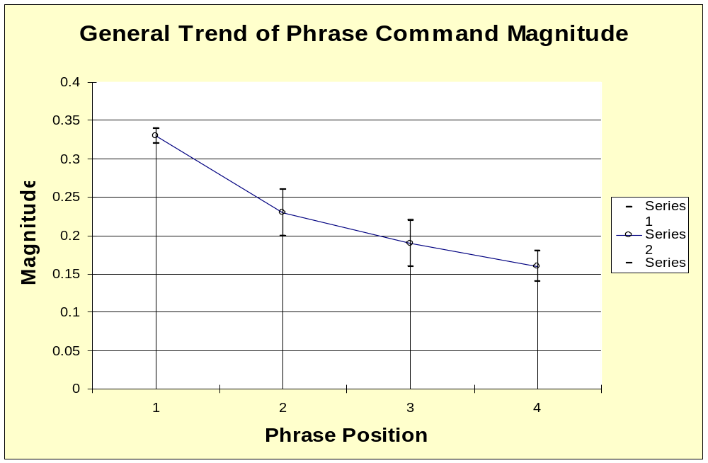
Results of Analysis of Phrase Commands
μ+σ
μ
μ- σ
1st
2nd
3rd
4th

Slide 56
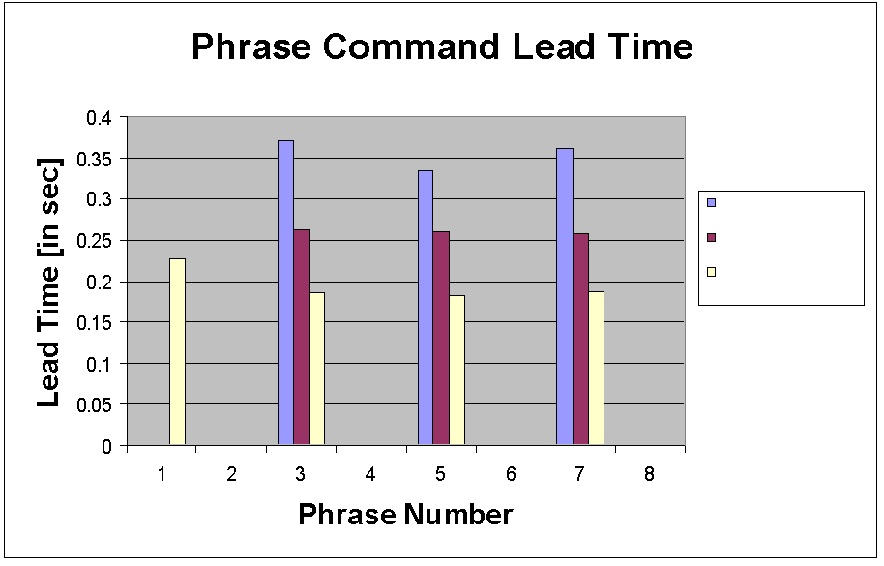
Results of Analysis of Phrase Commands (cont’d)
Pause>0.250
0.1s≤Pause≤0.250s
Others
1
2
3
4≦

Slide 57
Results of Analysis of Accent Commands
Position |  | Accent command amplitude (A_{aj})
 |  | Negative | Positive
Utterance-initial |  | - 0.325 (σ = 0.06) | 0.232 (σ = 0.05)
Utterance- medial | Phrase- initial | - 0.317 (σ = 0.05)
 | Phrase- medial | - 0.261 (σ = 0.08)
Utterance-final |  | - 0.328 (σ = 0.09) | -

Slide 58
Results of Analysis of Accent Commands (cont’d)
Position | Value of t₁ [s]
Utterance-initial | 0.148
Utterance-medial | Pause ≥0.10 s | 0.147
 | Pause<0.10 s | Voiced | 0.071
 |  | Unvoiced | 0.111
Word Length | Value of t₂ [s]
Monosyllabic | 0.176
Polysyllabic | Syllable Type: ‘V’,’VC’,’CV’ | 0.037
 | Syllable Type: ‘others’ | 0.071

Slide 59
Evaluation Method
Objective evaluation
  The original F₀ contour is compared with the synthesized F₀ contour and the root mean squared value of the difference is 0.041.
Subjective evaluation
  The two sets (I.e., original and synthesized) of 50 sentences were randomly mixed.
  These were presented to 5 subjects for giving their judgment on the naturalness on a 5-point scale
  (5: very good , 4: good, 3: neutral, 2: poor, and
  1: unacceptable).

Slide 60
Evaluation Results
Mean opinion scores for the original and the synthesized speech
Score |  | Subject
 |  | L1 | L2 | L3 | L4 | L5
Original | Avg | 4.64 | 4.52 | 4.58 | 4.70 | 4.62
 | Stdv | 0.56 | 0.58 | 0.67 | 0.54 | 0.49
Model- generated | Avg | 4.52 | 4.44 | 4.52 | 4.64 | 4.56
 | Stdv | 0.71 | 0.68 | 0.71 | 0.62 | 0.67
Results of ANOVA reveals that
differences within each speaker and across the speakers are not significant at all

Slide 61
Unicode Bangla Text
Language Dependent
Text analysis for Phrase/clause boundary and functional POS
Grapheme to Phoneme Conversion (G2P)
Duration Modeling
Intonation (F0) Modeling
Fujisaki Model
Pause Modeling
ESNOLA based TTS
HTS based TTS
Partname signal Dic.
#5 Mb
Segmental signal Dic.
#2Gb
Light weight TTS
Heavy weight TTS
Synthesized Output

Slide 62
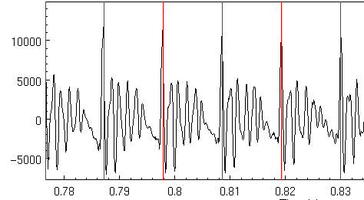
Speech as Short Term signals

Slide 63
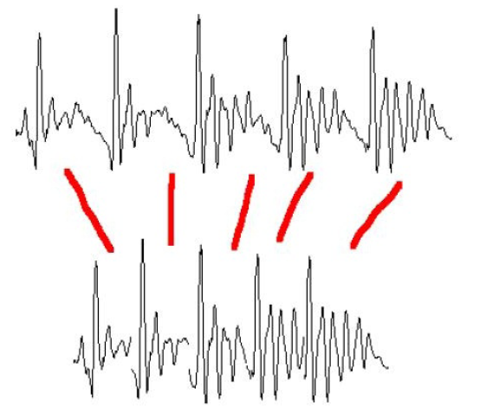
Pitch Modification
Move short-term signals closer together/further apart

Slide 64
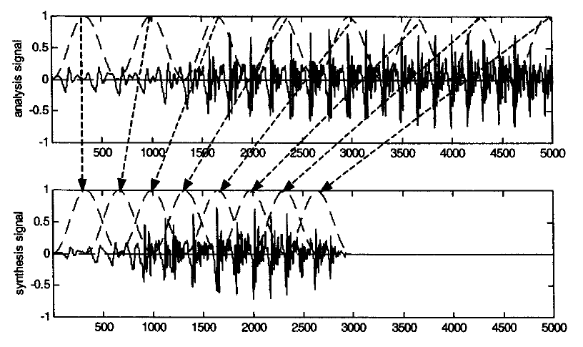
Overlap-and-add (OLA)

Slide 65
Overlap and Add (OLA)
Hanning windows of length 2N used to multiply the analysis signal
Resulting windowed signals are added
Analysis windows, spaced 2N
Synthesis windows, spaced N
Time compression is uniform with factor of 2
Pitch periodicity somewhat lost around 4th window
Huang, Acero, and Hon

Slide 66
TD-PSOLA ™
Time-Domain Pitch Synchronous Overlap and Add
Patented by France Telecom (CNET)
Very efficient
  No FFT (or inverse FFT) required
Can modify Hz up to two times or by half
Slide from Richard Sproat

Slide 67
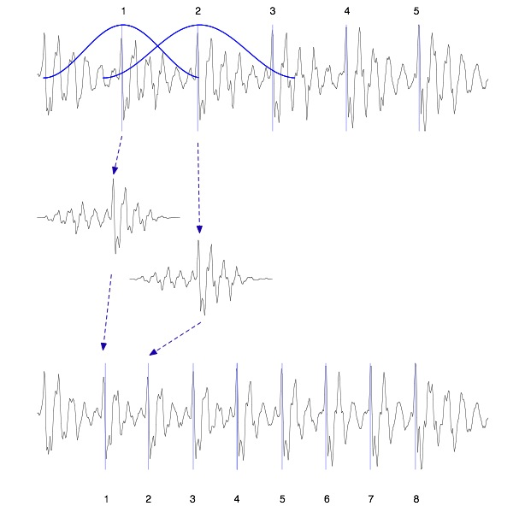
TD-PSOLA ™
Windowed
Pitch-synchronous
Overlap-
-and-add

Slide 68
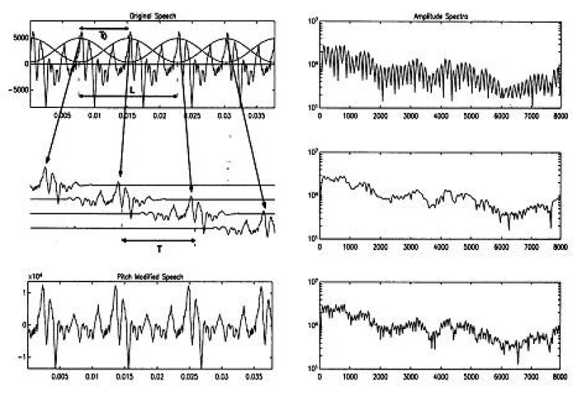
TD-PSOLA ™

Slide 69
HMM synthesis
A quite new technology is speech synthesis based on HMM, a mathematical concept called Hidden Markov models.
It is a statistical method where the text-to-speech system is based on a model that is not known beforehand but it is refined by continuous training.
The technique consumes large CPU resources but very little memory.
This approach seems to give a better prosody, without glitches, and still produces very natural sounding, human-like speech

